Slide 1

Inclusion patterns in a diverse classroom
Developing reading skills for slow readers and ELL

Slide 2

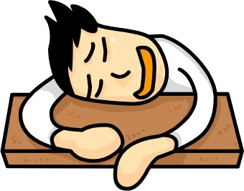
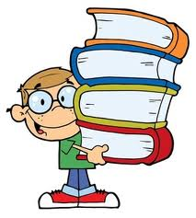
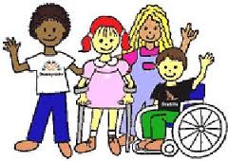
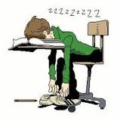
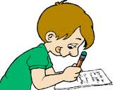

Slide 3

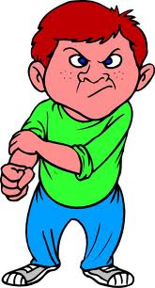
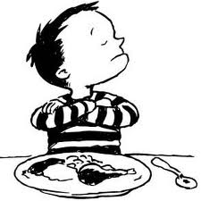
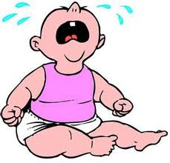
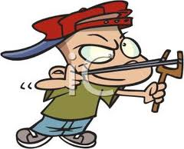
Socrates-Greek philosopher in Athens (469 BC - 399 BC)
Children today are tyrants. They contradict their parents, gobble their food, and tyrannize their teachers.

Slide 4
“Success for Every Child”
  Adopting an approach to designing education, based on the concepts of universal design, that will anticipate and provide support for the diversity of learners in today’s classrooms.
  Alberta Education

Slide 5
What is brain based teaching?
Brain-based teaching is best understood in three words: engagement, strategies, and principles. Brain-based teaching is the "engagement of strategies based on principles derived from an understanding of the brain."

Slide 6
Knowing the brain

Slide 7
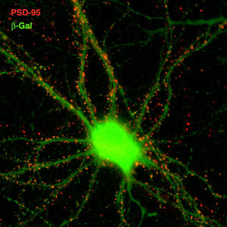
Visualizing dendrites

Slide 8
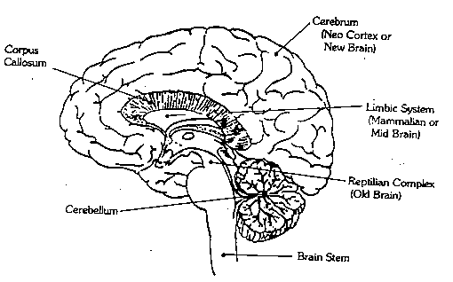
Three brothers in education
Notes:
Affective domain was reflected in the writing of Dewey, Montessori, and Vygotsky in the first part of the XX- th century, and gained importance with the growth of humanistic psychology in the 1960’s. The work of C.R. Rogers has become increasingly relevant to a discipline that recognizes the importance of affect on the learning situation and sees each learner as an individual

Slide 9
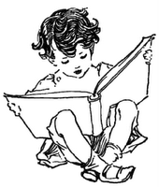
Good Readers
Read ahead, Read back, Look at the pictures, Ask questions, Make Predictions, Summarize, and Re-Read.

Slide 10
Reading process
Reading is a complex cognitive process of decoding symbols in order to construct or derive meaning (reading comprehension).
It is a means of language acquisition, of communication, and of sharing information and ideas.

Slide 11
Reading process
Decoding -to translate symbols into sounds or visual representations of speech; the interpretation of symbols to extract the meaning.
Comprehension- Readers integrate the words they have read into their existing framework of knowledge or schema.
Use of morphemes, semantics, syntax and context clues to identify the meaning of unknown words.

Slide 12
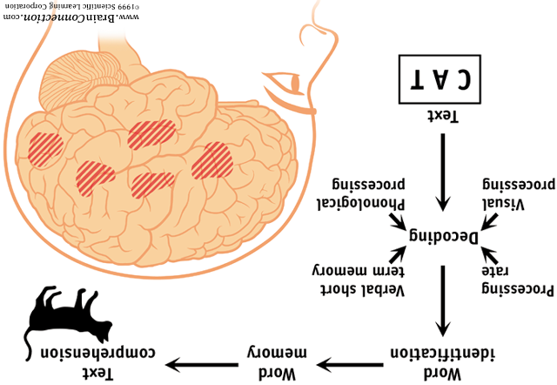
Reading process

Slide 13
Pre-reading - Context Clues: “get hurt” & “commuters”
Check your vocabulary knowledge. Fill in the circle before the word or expression from the list with the same meaning as the bold word in the sentence:
Schools are trying to ensure that no student gets hurt in the basketball court. They have enforced strong rules for the use of the court.
                “gets hurt” means:
  become injured
  take care
  receive a pass
  help somebody get across the street.
The bus arrived late in the station. There were a number of commuters waiting at the station to go to school and work.
                “commuters” means:
  people who cook for others
  community members
  regular travelers from home to school or work
  people who deliver newspapers

Slide 14
“ride” & “faint”
The bus tickets are getting more expensive each day. However, many commuters have no other way to go to work or school. Therefore, they continue to ride the bus or the train.
                “ride” means:
  learn how to drive the bus or train
  travel as passengers in a bus or train
  buy a new car or bus
  clean a vehicle that is dirty
A grade eleven student suffered from a heart disease and was put on strong medication. Yesterday she was taken to hospital because she fainted in her gym class.
                “fainted” means:
  participate in a practice session
  lose (lost) consciousness briefly
  score a goal in the gym class
  be absent from school due to illness

Slide 15
“steering wheel” & “swerve”
The new driver was very nervous. He was taking the behind the steering wheel test.
                “steering wheel” means:
  the wheel of a heavy truck
  the wheel of fortune game show
  a means of guiding a vehicle
  your uncle’s wife driving test
There was a snow storm last night and many drivers lost control of their vehicles. My friend was driving in an icy road and he swerved the car into a ditch to avoid hitting a tree.
                “swerve” means:
  turn away from direct course
  learn how to drive in icy roads
  turn to the right and to the left
  run away from dangerous roads

Slide 16
“brake pedal”
My grandmother still drives at 80 years of age. However, it is hard for her because she is so short that she can hardly reach the brake pedal now.
                “brake pedal” means:
  break off a relationship with her next door neighbour
  a foot operated part of a vehicle that is used to slow down or stop a vehicle
  make something move faster than ever before the accident
  play a musical instrument that was found in a museum in Toronto

Slide 17
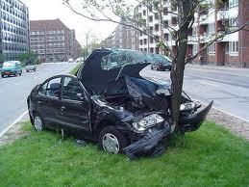
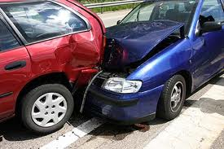
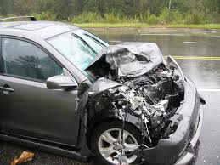
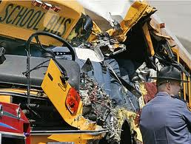
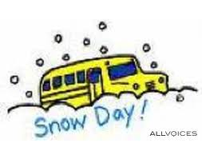
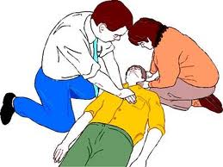
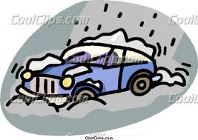
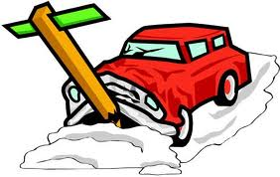
Pre-reading- What do the pictures tell you about the story you are about to read?

Slide 18
Evoke previous experience
Have you ever been in a car accident? _____________________________________________________________
What did you do when you understood what was happening? _____________________________________________________________
What are the main reasons people get involved in a car accident? _____________________________________________________________
Have you heard of people who help others in a case of car accident? What did they do to help? _____________________________________________________________
What should we do in case of an emergency? _____________________________________________________________

Slide 19
http://www.cnn.com/2011/HEALTH/05/12/ep.kid.save.life.bonifield/index.html

Slide 20
Town Hero
This story happened in a small town in Alberta. Up to 15 centimetres of snow, combined with a train derailment that blocked the railway tracks used by the West Coast Express, had led to long delays for the commuters. The bus trip to school was not expected to be easy that day. The weather forecast announced that the weather would not be improving anytime soon. Another major headache, the snow, had also delayed school buses throughout the School District. The winter weather, which was at its most extreme that day, had hit the region since last weekend. This might have contributed to a number of car crashes like the one that killed a 20-year-old woman on Sunday.
After the accident, the doctor who examined the driver concluded that the medicine had caused him to faint. An accident like that could have killed all the students. Albi’s heroic act saved the lives of so many of his friends. He became very popular in his school and was considered as the town hero.

Slide 21
Town Hero cont…
On a day like that, a young student, Albi, became a hero at his school and became the talk of the city. The tenth- grade student brought a run-away bus to a safe stop. He saved thirty of his classmates from getting hurt. Such an action made him popular. This is what happened:

Slide 22
Town Hero cont…
Albi was riding to school on the school bus as usual. The bus driver fainted at the wheel. The bus began to swerve. It started going faster and faster on the streets of the snow-covered and icy town. Albi rushed to the driver’s side and instantly understood that the driver could not control the bus due to a health condition. Albi’s life and the lives of his friends were in real danger. Albi made a quick decision. He pushed the brake pedal to slow down the bus. Then he turned the steering wheel and brought the run- away bus to a safe stop in the school driveway. What had happened to the driver? The driver had been sick for a number of days. He had to take some strong medicine that morning. To make matters worse, the roads were frozen and it was snowing heavily.

Slide 23
Prediction………
How do you think this story ends?

Slide 24
Vocabulary Log: Find the definition for the following words in your dictionary. Create an entry for each word for your future reference. Write a sentence for each word..
Here is an example for your reference: “happen”
Definition- to take place,
Synonym – occur
Sentence - This story happened last summer in my town.
derailment
definition………………………………………………………………………..
sentence…………………………………………………………………………
commuters
definition………………………………………………………………………..
sentence…………………………………………………………………………

Slide 25
VOCABULARY BUILDING - Insert the right word in the blanks. Use the words from the list below.
The sentences are taken from the story “ The Town Hero”.
run-away bus derailment commuters delays fainted brake pedal slow down weather forecast
swerve steering wheel
The trip to school was not expected to be easy, as _________________________ announced, the weather would not be improving anytime soon.
The tenth- grade student brought a ____________________ to a safe stop.
The bus driver ____________________at the wheel.

Slide 26
VOCABULARY BUILDING - Use the words you learned in the story “The Town Hero” in a new context:
derailment commuters medical delays weather forecast faint(ed) brake pedal slow down swerve steering wheel run away bus popular
According to police, the accident happened due to a ________________ problem.
The snowstorm caused a _______________during the morning commute.
The mudslides caused dangerous ________________ of the train tracks.
In order to avoid hitting the little dog, the driver ______________ the car into a ditch.

Slide 27
VOCABULARY BUILDING – Match the words below with the definitions in the box.
…brake
…steering wheel
…swerve
…slow down
…popular
…run away bus
a) well-liked, admired, accepted
b) a vehicle that ran off without control
c) part of a vehicle that controls the movement
d) turn sharply, change direction
e) reduce speed by using the brakes
f) restrain, reduce speed

Slide 28
Anagrams - Unscramble the words below:
Swerve
Medical
Faint
Break
Popular
Steering wheel
Commuters
revesw____________;
alicdme___________;
intaf_________;
rabek________;
upoparl__________;
ngieerts ________hleew______;
socmumert ____________;

Slide 29
Personal Response
Write a letter to Albi and share your feelings about his actions?
Write another story about a person who saved lives.
Write a letter of appreciation to a Canadian peacekeeper.

Slide 30
Other vocabulary building activities
http://www.2learn.ca/r2l/languageArts.aspx?type=154
http://www.2learn.ca/teens/listLAReading.aspx?Type=1http://education.jlab.org/beamsactivity/6thgrade/wordsearch/stu01.l.html
http://education.jlab.org/beamsactivity/6thgrade/wordsearch/tea01.l.html

Slide 31
What is Universal design (UDL)?
……a set of principles for curriculum development that gives all individuals equal opportunities to learn.

Slide 32
S0,…how do I use UDL?
Consider it a blueprint for creating instructional goals, methods, materials, and assessments that work for everyone--not a single, one-size-fits-all solution but rather flexible approaches that can be customized and adjusted for individual needs.

Slide 33
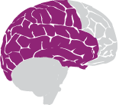
Recognition Networks
The "what" of learning
How we gather facts and categorize what we see, hear, and read. Identifying letters, words, or concepts are recognition tasks.

Slide 34
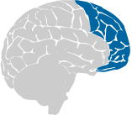
Strategic Networks
The "how" of learning
Planning and performing tasks. How we organize and express our ideas. Writing an essay or solving a math problem are strategic tasks.

Slide 35
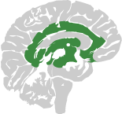
Affective Networks
The "why" of learning
How learners get engaged and stay motivated. How they are challenged, excited, or interested. These are affective dimensions.

Slide 36

Universal Design for Learning (UDL)
  has origins in architectural studies
  challenged architects to become innovative, to design buildings which provide access for all
  is a result landmark legislation which has increased usability for everyone
  examples: ramps, elevators, automatic doors, curb cut and closed caption TV

Slide 37

Universal Design Principles
Universal Design for Learning (UDL) is an approach to designing course instruction, materials and content to benefit people of all learning styles
It provides equal access to learning by removing barriers
Allows the student to control the method
of accessing information without
adaptation or retrofitting
http://www.cast.org/teachingeverystudent/ideas/tes/
Teaching Every Student in the Digital Age: Universal Design for Learning
David H. Rose & Anne Meyer ASCD, 2002

Slide 38


Slide 39


Slide 40
Let’s keep talking……
Contact information:
  Adriana Bejko
  12dracana@gmail.com
  abejko@ambrose.edu

